Slide 1

Presentation (Review-I) on Lesion Detection And Segmentation of multiple Sclerosis using deep learning By Anannya Londhe 70012100223 Pallavi Dangane 70012100227 Khushi Patil 70012100165 Under the Guidance of Prof. Pravin Landage Sir
Information Technology Department
(or Department of Artificial Intelligence and Machine Learning)
MPSTME, Shirpur
Academic Year: 2024-25

Slide 2
Problem statement
Lesion Detection And Segmentation of multiple Sclerosis
What is Multiple Sclerosis?
Multiple sclerosis (MS) is a disease where the immune system attacks the central nervous system (CNS), causing nerve damage and leading to symptoms like inflammation and neurodegeneration. Diagnosing MS involves clinical exams, MRI scans, and lab tests based on the 2017 McDonald criteria. MRI is crucial for identifying MS lesions, making automated lesion detection important for tracking the disease.

Slide 3
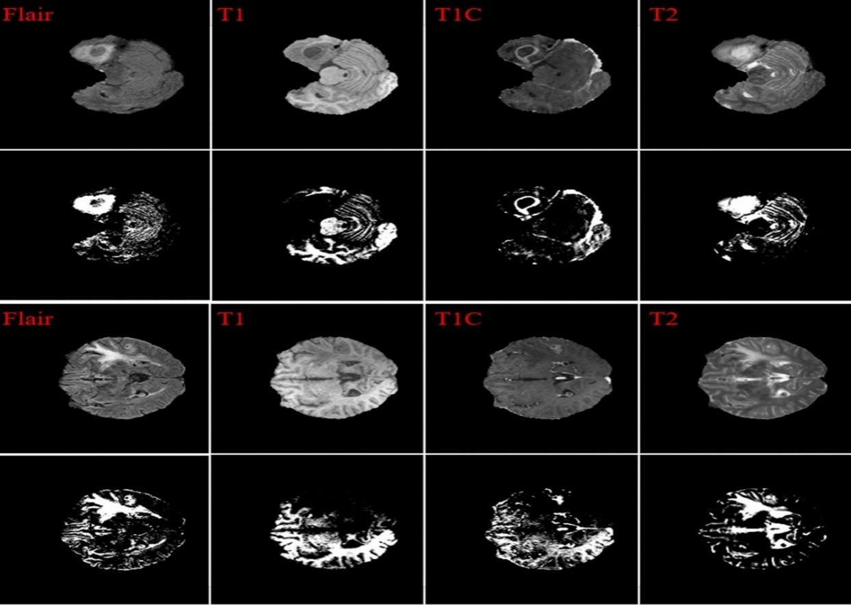
What is Lesion Detection and segmentation?
Lesion Detection
The process of identifying abnormal areas, or lesions, in medical images (such as MRI scans). These lesions can indicate the presence of diseases or conditions.
Lesion Segmentation
The process of delineating or marking the exact boundaries of the lesions identified in the images. This involves separating the lesion from the surrounding healthy tissue.

Slide 4
Application and Scope
Clinical Diagnosis
Automated lesion detection and localization in MRI scans.
Accelerated diagnostic process and reduced radiologist workload.
Quantification and Monitoring
Accurate lesion segmentation for volume quantification.
Assessment of disease progression through volume and number changes.
Research and Development
Analysis of large MRI datasets to discover new patterns and biomarkers.
Evaluation of new drug and therapy efficacy in clinical trials.

Slide 5
Detailed Literature Review
Multiple sclerosis lesion detection in multimodal MRI using simple clustering-based segmentation and classification
Challenges:
Brain parts and lesions often have similar intensity values, complicating accurate segmentation.
Variability in MRI scans across different subjects can affect consistency in lesion detection.

Slide 6
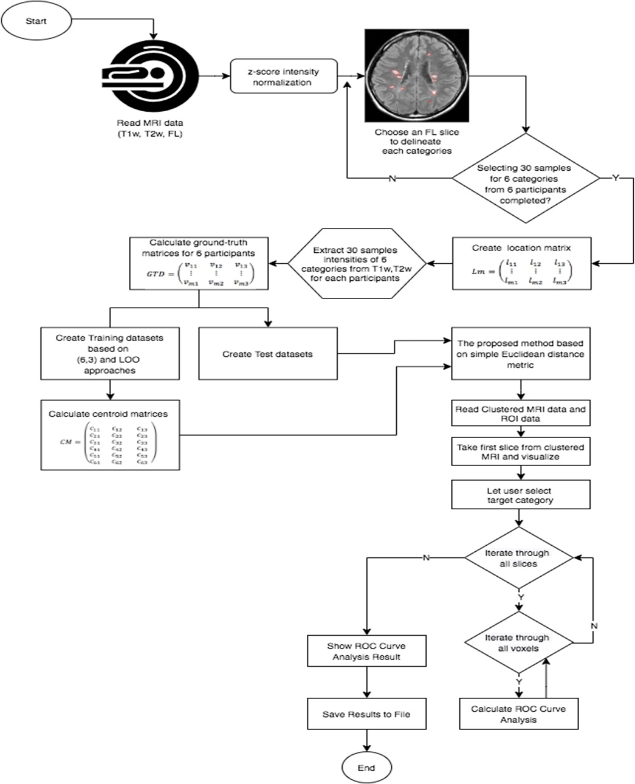

Slide 7
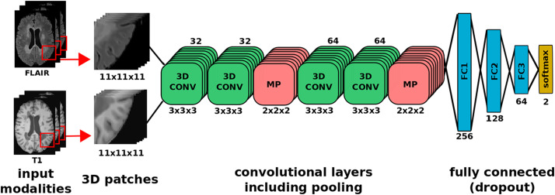
One-shot domain adaptation in multiple sclerosis lesion segmentation using convolutional neural networks

Slide 8
Automatic MS Lesion Segmentation with Random Forests
Problem: Manual segmentation of MS lesions in MRI scans is time-consuming, suffers from high intra- and inter-rater variability, and limits consistent disease monitoring.
Solution: Automatic segmentation using Random Forests (RF), a machine learning technique, offers improved reproducibility and consistency.
Method:
Trains RFs on features extracted from multi-spectral MRI data (FLAIR, MPRAGE, T2w, PD) including intensity values, local histograms, and spatial location.
Achieves performance near inter-rater quality in terms of Dice's Coefficient, lesion true positive rate, lesion false positive rate, and lesion average symmetric surface distance.
Shows promise for longitudinal disease monitoring through future incorporation of longitudinal correspondence.

Slide 9
Research Gaps Identified
Determining the optimal patch size that balances local detail and global context remains challenging.
- Smaller patches: May miss broader contextual information.
- Larger patches: Can be computationally expensive and dilute local details.
Random Forests can be biased towards the majority class in imbalanced datasets.
Standard clustering algorithms often ignore spatial relationships between pixels or voxels, which is crucial for medical image analysis.
Medical images are often high-dimensional, making traditional clustering algorithms inefficient and prone to the curse of dimensionality.

Slide 10
Proposed Solution

Slide 11
References
[1] Ozdemir Cetin , Volkan Seymen , Unal Sakoglu
Multiple sclerosis lesion detection in multimodal MRI using simple clustering-based segmentation and classification
Informatics in Medicine Unlocked ,Volume 20, 2020, 100409
[2] Oskar Maier, Heinz Handels
MS-LESION SEGMENTATION IN MRI WITH RANDOM FORESTS
Institute for Medical Informatics, Universit¨at zu L¨ubeck Graduate School for Computing in Medicine and Life Sciences, Universit¨at zu L¨ubeck
[3]Sergi Valverde, Mostafa Salem, Mariano Cabezas, Deborah Pareto, Joan C. Vilanova, Lluís Ramió-Torrentà, Àlex Rovira, Joaquim Salvi, Arnau Oliver, Xavier Lladó
One-shot domain adaptation in multiple sclerosis lesion segmentation using convolutional neural networks National Library of Medicine, National Center for Biotechnology Information
[4] Dawood Tafti; Moavia Ehsan; Kathryn L. Xixis
Multiple Sclerosis
National Library of Medicine, National Center for Biotechnology Information

Slide 12
THANK YOU!!

